Slide 1
Long Call Timer
Project Report
By-
Abhishek Raj Permani
SRIB Intern’ 20

Slide 2
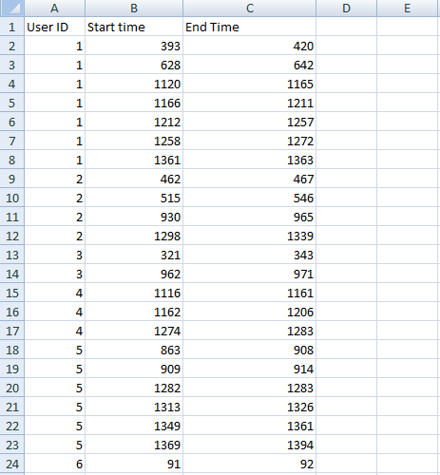
Data Set-

Slide 3
Data Set understanding
Data set of users with their start and end time of each call by User ID.
There are 3 columns- User ID, Start time , and End time.
Assumed scale of 0 to 1440 minutes , for 24 hours.
Maximum call duration of each call is assumed to be 45 minutes, after that the call hangs up, and user needs to redial again.
Data set is sorted by users.

Slide 4
Problem
We have to find the value of time after which the particular call ends, user have to redial it again.
This value cannot be very small also cannot be very large, it should be optimal.
We have to satisfy at least a fix percentage of users given, by predicting that time value.
Percentage of users satisfied is calculated as (if we have fixed a value of time of ending the particular call say curr_val), percentage of users having call duration not more than our fixed value that is curr_val.

Slide 5
Assumption
There are sufficient number of connecting lines for number of users given.
Many users can simultaneously make phone calls over the network.
While making this data set, we have assumed that around 17% of total calls has more than 45 minutes of time duration.

Slide 6
Approach
Using the current users data,we can predict their duration of call time for their next iteration using statistical models like ARIMA model.
Having done that we will be able to predict the value of time required in order to satisfy a given percentage of users (say 90%)by using simple models.

